Slide 1
Welcomes you to the World of Online/Virtual Exhibitions
In Tune with the Digital Age

Slide 2
Organiser of Domestic Exhibitions in Chennai since 2005
International Exhibitions since 2012
Organised So far 62 editions in 9 countries
India, Kenya , South Africa , Nigeria , Sri Lanka, Myanmar & Vietnam and soon in Ethiopia & Nepal
9300+ Exhibitors
500000+Visitors

Slide 3
Expertise in organizing Expos on different Subjects / Scales / Modules
On Geographic Representation
Across Globe
Continent Specific
Country Specific
Regional Specific
Province or State Specific
Classification Oriented
Broader Subject
Narrow Subject
Precise Subject

Slide 4
Launching the Perfect Platform for Online / virtual Exhibitions
i Series of all our Own Brands

Slide 5
Why Online / Virtual Exhibitions ?
COVID 19 & TECHNOLOGY Disruptions
Space and Time Borders destroyed
Work from Desk has lead to Source from Desk too
Cost-effective
Expanded and Deeper reach to target groups
Green and sustainable
If e commerce ( B2C) has grown leaps and bounds in the recent years
Why not B2B Online Expos ?
SMART EXPOS IS THE FIRST ONE IN INDIA TO EMBRACE THIS INNOVATION

Slide 6
Let’s take a Tour on the Features of ONLINE / VIRTUAL Exhibitions
KEY OBJECTIVE
To Enable Connect between
The Seller and
Hitherto
UNCONNECTED / NOT KNOWN Contacts in many countries

Slide 7
Welcome Hoarding
As in the On ground exhibition when you are on the way to the exhibition venue and you will be greeted with prominent hoarding on the way.
No visitor will miss this signage

Slide 8
Registration and Login
After entering the exhibition venue , the visitors will land on this registration page
Visitor details will be collected here
The Email Verification will be done and login Credentials confirmed

Slide 9
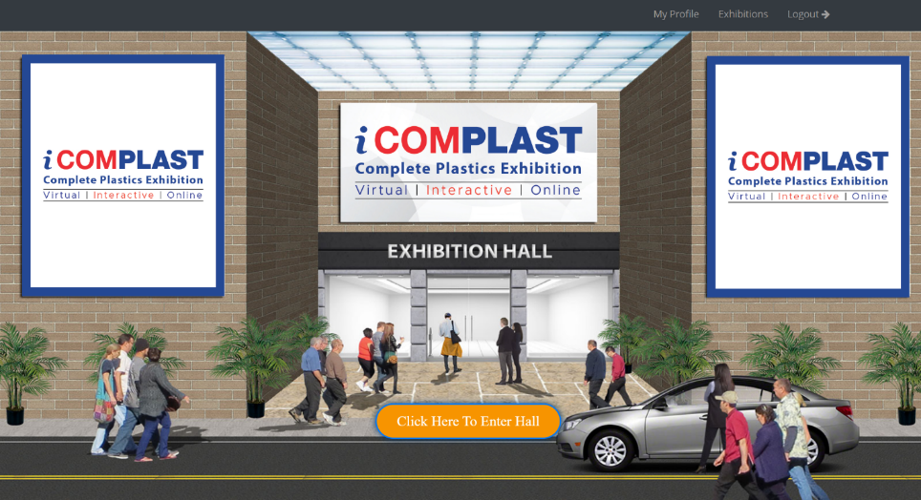
Exhibition Hall – Virtual Entrance
Once Registration is done, visitor will be guided to enter the Hall
There are 2 Branding Options Available for Organizer or Sponsor
This page will also be visited by every visitor.

Slide 10
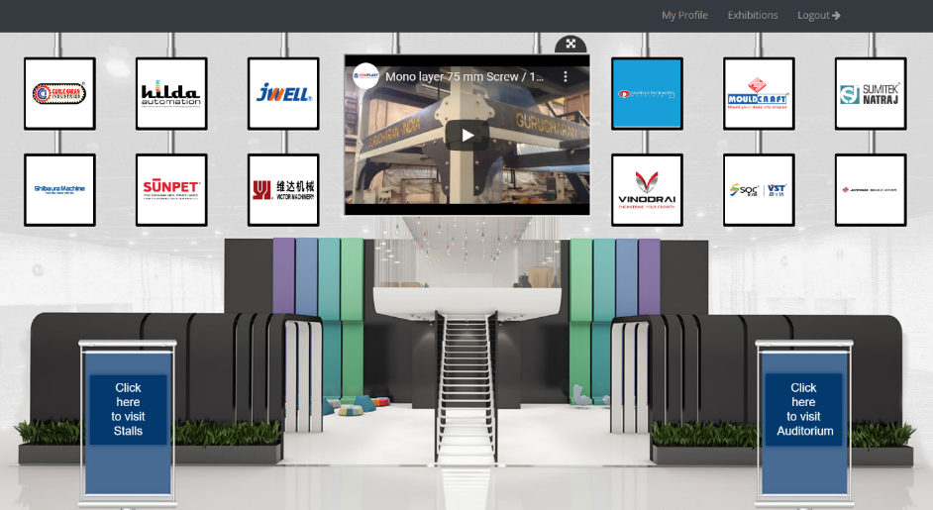
Virtual Lobby
After registering, all visitors will land on the virtual lobby page.
Promo or About the Expo films can be screened here
Visitors will enter the stall area by Clicking on the left panel
Enter the auditorium by clicking
the right panel

Slide 11
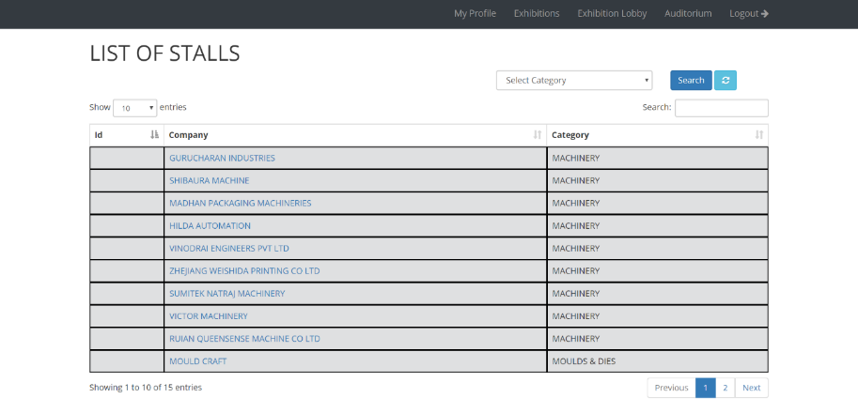
Information on Exhibitors / Categories / Pavilions
The Exhibitor Details can be viewed on different module
Alphabetic wise
Exhibitor Category / Subcategory / Profile
Country wise
Search By Exhibitor name
This panel will undergo substantial change in Commercial Plot with more specification / well - routed

Slide 12
The New Panel will have
MAIN CATEGORY
SUB CATEGORY
CAN BE SORTED BY
EXTENDED SEARCH
Broader Categories of the Sector
Exhibitor Index A-Z
By Region / Country
Product Wise
Stand Activity Wise
Area of Business
Exhibitor Criteria
Topic Oriented
Product Oriented
Hall Wise
Exhibitor List under Each Category
Which will take you directly to the Booth
Gives More Information about them

Slide 13
VIRTUAL BOOTH OPTIONS!

Slide 14
Premium Booth
This is a Premium booth type, where in the exhibitors will have
4 display panel on the backdrop & 2 display standee for their display of products and services.
TV on center of the backdrop for playing pre recorded videos
1 logo space on table front.
Space for profile pic or company logo
Fascia name (company name)

Slide 15
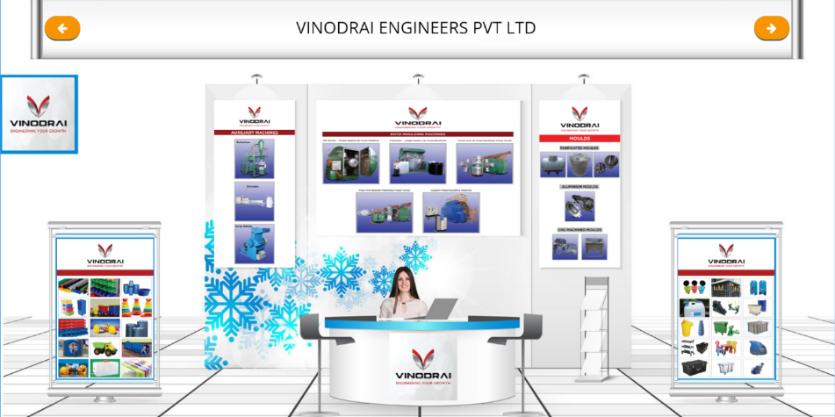
Executive Booth
This is a Premium booth type, where in the exhibitors will have
3 display banner space and
2 display standees
1 logo space on table front.
Space for profile pic or company logo
Fascia name (company name)

Slide 16
Standard Booth
This is a standard booth type, where in the exhibitors will have
2 display banners
1 display standee
1 logo space on table front.
Space for profile pic or company logo
Fascia name (company name)

Slide 17
Basic Booth
This is a basic booth type, where in the exhibitors will have
1 display spaces on the backdrop & 1 display standee, on which the exhibitors can display their products / services.
1 logo space on table front.
Space for profile pic or company logo
Fascia name (company name)

Slide 18
BOOTH FEATURES!

Slide 19
All Booth types have the following features
All Display Spaces & Display Standees will POP Out on clicking for easy reading / visibility
All Booth options have common buttons like:
About us (company profile can be displayed there)
Download Brochure button (visitors can download the exhibitor’s brochures)
Contact button (Exhibitors contact details will be mentioned there)
Web URL (on clicking, visitors will be redirected to exhibitor’s website)
Chat function (Exhibitor and visitor directly can chat with each other) Not in demo Now
Video calling function (Exhibitors and visitors can have a video chat) NOT NOW
Send Inquiry button (Visitors can simply type their requirements and send). Exhibitors will be able to see these inquiries in their respective dashboard)
Drop contact details. When visitor clicks this icon the contact details provided in the Registration will be sent to the Exhibitors respective dashboards)

Slide 20
EXHIBITOR DASHBOARD
Complete Management of Booth
Metrics collected for total Event / Exhibitor Booth
Know your Audience Better
Analyze and Gauge the Prospects
Complete Event Reports @ 1 Click
Tracking with measurable reports

Slide 21
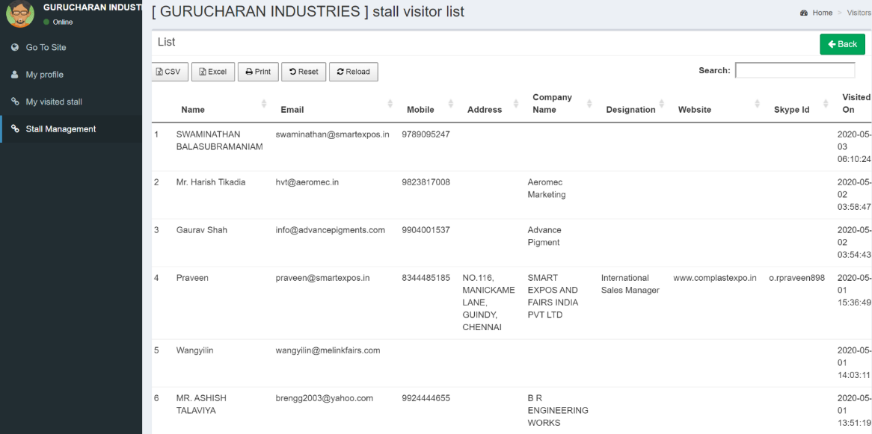
The Exhibitor can see the number of Visitors who visited his booth, with the complete information of the Visitor like Mobile, Address, Social Media Connect, Timelines he spent on his booth etc

Slide 22
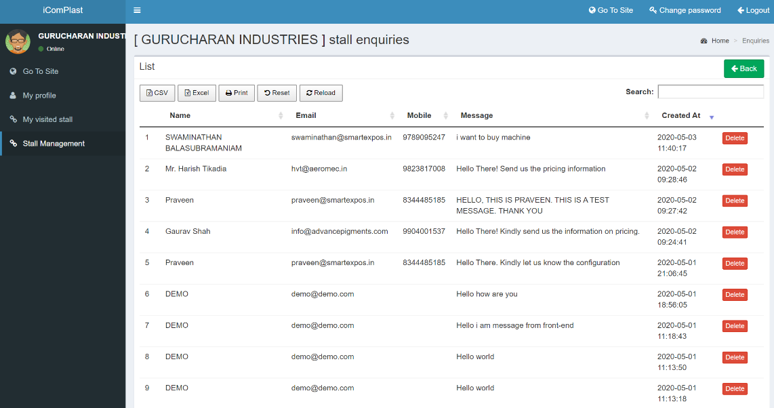
A Detailed Report on Enquiries generated will be recorded here with actual conversations. The Exhibitor can access all the enquiries and follow up later to for concluding business

Slide 23
All the reports can be exported as CSV File for saving the contacts and other Connections. Downloaded as Excel Sheet for reference. Print Option is also available
Video Call / Audio Chat Reports also can be downloaded.

Slide 24
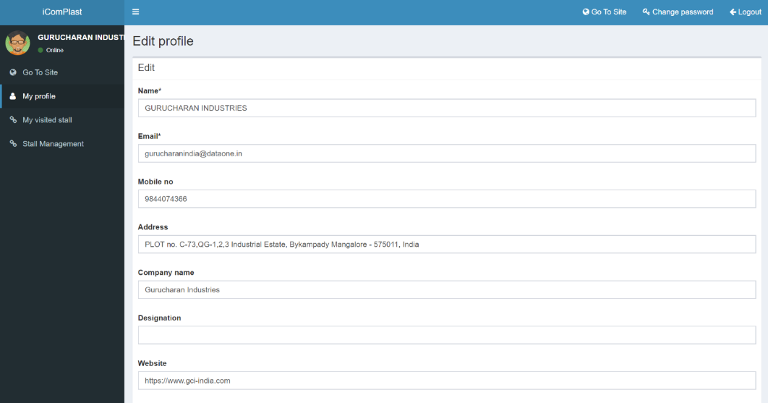
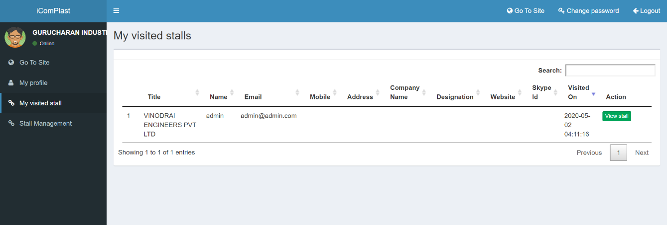
The Exhibitors can edit their profile anytime with updated Information.
The Exhibitor also can visit other booths in the exhibition – his connections will be saved for future ref

Slide 25
VISITOR DASHBOARD
Live Tracking of Visits
Instant Interconnect Options
Acts as a Virtual Briefcase
Complied Visit History
Interactions saved and retrieved back for future follow-ups

Slide 26
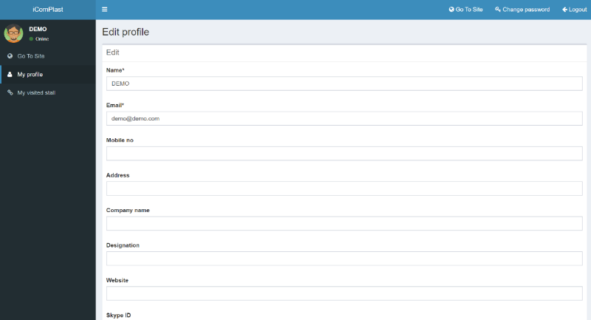
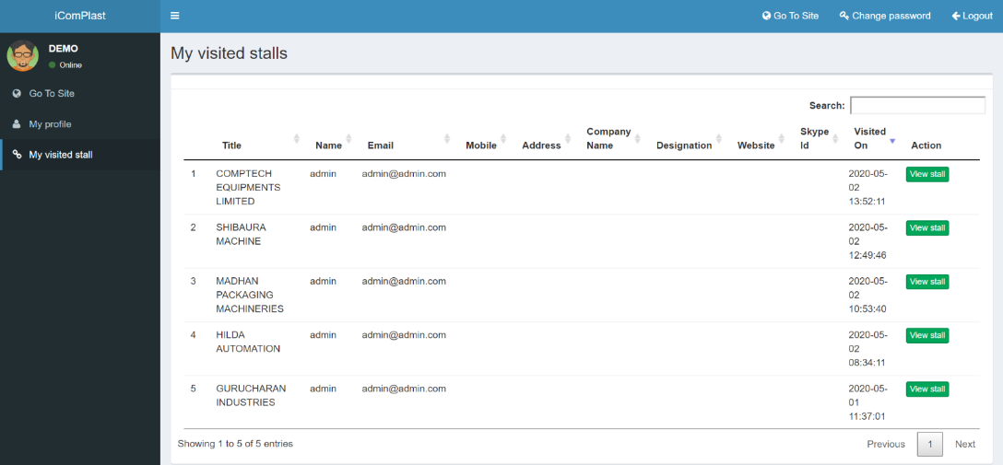
All the Visited Stalls, Information collected, discussions made will be recorded for Future reference on visitor’s dashboard
The Visitors are also open to edit their profile anytime with updated Information.

Slide 27
Auditorium – Optional Feature
From the virtual lobby, visitors can enter the Auditorium.
Pre recorded presentations can be played or sponsors videos can also be played
d. o
On top, left and right corners branding options are available

Slide 28
Future Features
Chatroom will be available from the commercial launch event
A Complete Networking Integration Platform
Virtual Briefcase for Visitors
Automated Self – Generated Runtime Reports
Easier Navigation ,Mapping and Search operations
Branding / Promotional Options for Sponsor’s
Visitor engagement , New enhanced features, great look and feel , newer designs, 3 D integration are on the anvil.

Slide 29
KEY MANTRA - DATABASE
We have huge Global Database of all sectors
Many countries
Accumulated for more than 15 years, refined every year.
Still acquiring database in more countries
Ensuring the last mile reach with
No Spam Data
More Classified - Sector Wise
Buyer Interest Oriented
More Authentic
More validated
Promotion Plans
A Perfect mix of Marketing Campaigns will be executed in all digital age platforms
E-Campaigns Promoting the Fair Promoting the Exhibitors also through the key Processors / Suppliers
Personalized Invites for Pre-registered Visitors
SMS campaigns
WhatsApp campaigns
Promotions through Social Media ( own Brand )
Industry Web Portals and many more

Slide 30
Our Proposal
Our Offer to EPCs / Chambers / Confederations – Services to include
Hosting the Virtual Expo / Online Exhibition
All Backend support will be provided . setting up booths , uploading promo materials
All promotion materials should conform to the technical specifications
Can be Hosted Exclusively for EPC / Chamber / Confederation members
Or
EPC / Chamber / Confederation can support Indian Exhibitors in our own brand of International Exhibitions
Marketing of Space to members will be the responsibility of EPC/ Chamber / Confederation

Slide 31
Visitor Promotion can be done, if desired and data provided by EPC/ Chamber / Confederation
Data available with SMART EXPOS can also be made available and may have limitations in terms of sector relevance
Promotions will include all digital form only e mail, WhatsApp or SMS
Social media promotion to be done by EPC / chamber / confederation
Suggested Duration of the Expo .. 5/7 working days Monday – Sunday
Summary report will be submitted if event is organised exclusively or support for Indian pavilion by EPC/ Chamber / Confederation or
In the event of Exclusive Hosting SMART EXPOS logo will be added as Organising Partner
In the event of Indian pavilion supported by EPC/ Chamber /Confederation we will the Organiser and your logo will be added as India Pavilion Supported by….

Slide 32
Schedule of Activities
Setting up involves substantial back end work and so strict adherence timelines essential
Exhibitors names to be finalised at least 21 days before the scheduled date of event
All Exhibitors must share promo materials as per our specifications and within the time
No change of collateral / promotion material possible during the event or from three days before the event
Event will be hosted on a trial basis for a limited group to check bugs etc
All features / facilities offered at the time of signing the contract will be final . No additional features can be included afterwards

Slide 33
Welcome to our Pilot Launch Visit, www.ismartexpos.com Login Credentials: Username: demo@demo.com Password : demo123 * Registration is not open for public / so the function disabled * Kindly use the above credentials and login directly
Any questions?
For More Information / Clarification:
B. Swaminathan | swaminathan@smartexpos.in | +91 97890 95247

